Slide 1

Cultural and Linguistically Responsive Pedagogy (CLRP)
Session presenters:
Dr. Wil Parker
Dr. Janette Hernandez

Slide 2
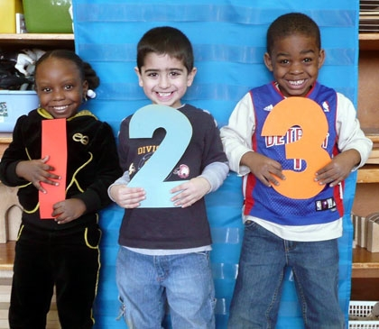

Slide 3
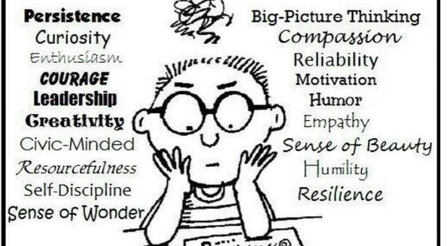
Who Do We Teach?

Slide 4
Agenda
Welcome
  Review norms and outcomes
Personal storytelling –similar, same, different
Unpacking book, Culturally Responsive Leadership, chapter 6
Critical Self Analysis and Reflection
Group Reflection/ Exit ticket
Learning walk

Slide 5
Outcomes
BRIDGE content with race and culture.
ENGAGE in narrative of what it means to be culturally and linguistically responsive school leader
  Individual experiences can cause systemic inequities
INVESTIGATE how leaders can change the narrative in schools
  Consider a new or revised role in implementing equity in classrooms and schools
COLLABORATE on developing/refining your own understanding and skills to act as an equity leader
  Who are your allies? How do you build relational trust? What are your core values that keep your grounded? When do you take risks?

Slide 6
Identifying and Supporting Black Male Students in Advanced Mathematics Courses Throughout the K-12 Pipeline.
- Davis, J., Anderson, C., & Parker, W. (2019). Gifted Child Today. https://journals.sagepub.com/doi/pdf/10.1177/1076217519842234

Slide 7
Article Recommendations
Increase Support Structures Provided to Black Males in Mathematics
Teachers Must Help Develop Black Male Students’ Identities
Prepare Teachers to Teach Black Male Students

Slide 8
Norms
Seek to understand & avoid making assumptions
Pay attention to and encourage equitable participation
Be on time
*Accept non-closure

Slide 9
Cultural Experiences Survey
Take a moment to answer a few questions..
Next, Ask yourself this question…
AM I LIKE MY STUDENTS??
What does this mean for teaching and learning?

Slide 10
Survey
Complete survey
Think, pair, share- Share what you want someone else to know (2 minutes each)
Summary prompt: Now, that I know this, I realize that….

Slide 11
Unpack Chapter 6
Use last word protocol to unpack
the salient points to inform your critical self reflection
Groups of 4

Slide 12

MEDIA
CLASSROOM
S to T
T to S
S to S
POLICY
SCHOOL
SOCIETY
DISTRICT
COMMUNITY
GREATER IMPACT ON STUDENT LEARNING
Notes:
Wil + Julius

Slide 13
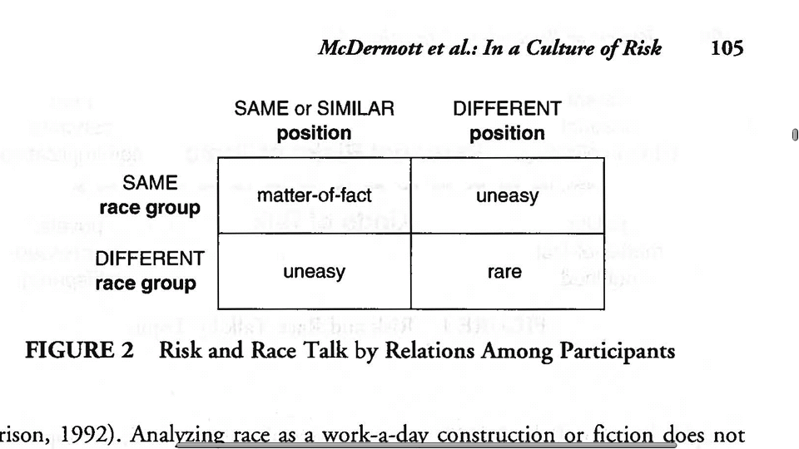
Risk, Race, and Culture Talk
By Relations Among Participants
McDermott, Raley, & Seyer-Ochi (2009)
Notes:
3 to 5 minutes Wil
Split up entire table and get with Thinking partner

Slide 14
TEACHER BEHAVIORS
Teacher Behavior
  Mindset
  Growth vs. Fixed
  Milner, 2009
Student Response
  Make Meaning
  Relationship
  Connections
  Tomlinson, 2006
Student Learning
  Engagement
  Ownership
  Accountable
  Freedom to Express
Resilient Learning Community
  Process Driven
  Strength and Caring
  Survivors not Victims
  Promotes Growth and Change
  Freedom to Express

Slide 15
Institutional and Individual Elements of Race and Ethnicity
Majors Consequences
*Policies, Practices and Professional Development that Maintain or Exacerbate Inequities, Unfair Acts and Racism Students’ Experience in Schools and Classrooms
Individual
*Blaming People for Conditions
*Belief that People Do Not Value Education
*No Discussion of Institutional Barriers and Racism
Institutional
*Policies
*Practices
*Professional Development
Notes:
Julius

Slide 16
Levels of Teacher, Counselor, Teacher Leader & School Leader Professional Development
Individual
Improve student learning and your own practice for culturally and linguistically diverse students
Department
Team Level
Improve student learning and the department/team’s practice
School & District
Building capacity for all school professionals to improve student learning
Professional Networks
Developing a national network and identifying practices to improve leadership, teacher practice and student learning.
Notes:
Julius

Slide 17
Critical Self Analysis and Reflection
Given the framing and the tools, what does it mean to be a CLR leader?
Where are you?
What can you do at each level and how can you shape it at each level? How does it look for your leadership team? Counselors, Teacher leaders?

Slide 18
Group Learning
Create a group visual that represents what it means to be a Culturally and Linguistically Leader? (consider the tools and resources)
Display on the wall using chart paper and supplies.

Slide 19
Exit Ticket
Today I have…….
Tomorrow I will…..

Slide 20
Learning Walk
Partner that will push your
conversation around race and culture

